Slide 1

Applications Development Practice 3 (ADP372S)
Lecturer: Kruben Naidoo
Email: NaidooK@cput.ac.za
Office: Rm 2.11 – Engineering Building, District Six Campus, Cape Town, South Africa.

Slide 2
Lesson objectives:
Welcome
Capstone group project presentations on campus
September Test Results and Queries
September (Sick) Test
The Command Design Pattern
The Interpreter Design Pattern
The Visitor Design Pattern
Summary

Slide 3
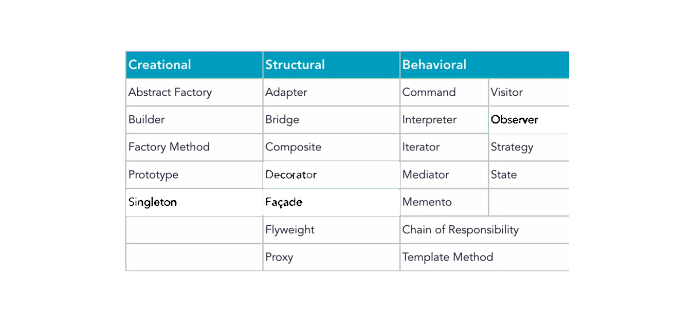
Recap
Figure: 23 Gang of Four (GOF) Patterns

Slide 4
The Command Design Pattern
A Command pattern is an object behavioral pattern that allows us to achieve complete decoupling between the sender and the receiver. (A sender is an object that invokes an operation, and a receiver is an object that receives the request to execute a certain operation.)
In a classic implementation, the command pattern requires implementing four components: the Command, the Receiver, the Invoker, and the Client.

Slide 5
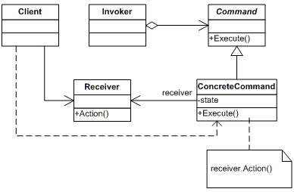
The Command Design Pattern class diagram

Slide 6
The Command Design Pattern
Watch the following video by Geekific
https://www.youtube.com/watch?v=UfGD60BYzPM

Slide 7
The Interpreter Design Pattern
Interpreter design pattern is one of the behavioral design pattern. Interpreter pattern is used to defines a grammatical representation for a language and provides an interpreter to deal with this grammar.
This pattern involves implementing an expression interface which tells to interpret a particular context. This pattern is used in SQL parsing, symbol processing engine etc.
Perhaps the best example of the interpreter design pattern is the java compiler that interprets the source code into bytecode that is understandable by the JVM.
Google Translator is also another example of the interpreter pattern.

Slide 8
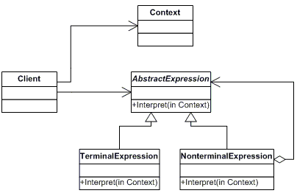
The Interpreter Design Pattern class diagram

Slide 9
The Interpeter Design Pattern
Example
add 200 and 75
or
subtract 35 from 100
Let us turn to IntelliJ to review the sample code.

Slide 10
The Vistor Design Pattern
Visitor design pattern is one of the behavioral design patterns. It is used when we have to perform an operation on a group of similar kind of Objects.
With the help of visitor pattern, we can move the operational logic from the objects to another class.
The visitor pattern consists of two parts:
a method called Visit() which is implemented by the visitor and is called for every element in the data structure
visitable classes providing Accept() methods that accept a visitor

Slide 11
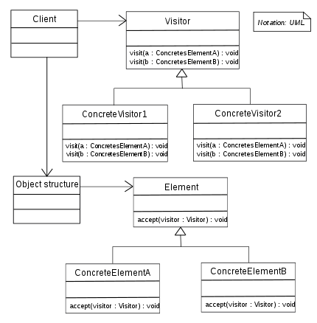
The Visitor Design Pattern class diagram

Slide 12
The Visitor Design Pattern Example
Let’s revisit an old example:
Interface Animal
Class Dog implements Animal
Class Cat implements Animal
Class Parrot implements Animal

Slide 13
The Visitor Design Pattern Example
Let’s look an example:
Interface Animal
+ makeSound()
Class Dog implements Animal
Class Cat implements Animal
Class Parrot implements Animal
makeSound() {
// dog
}

Slide 14
The Visitor Design Pattern Example
In the example, we note a few problems in the implementation:
Nightmare to manage code changes across concrete classes
Violation of the Open Closed Principle (OCP)
Violation of the Single Responsibility Principle (SRP)
Single Dispatch vs Double Dispatch
Let move to IntelliJ to discuss further…

Slide 15
The Visitor Design Pattern Example
 | (R1000) | (R5000) | (R20000)
 | Bronze | Silver | Gold
Kulula Flights | 15% | 25% | 50%
Nike Store | 5% | 7% | 10%
Hotel accom. | 25% | 35% | 60%
???

Slide 16
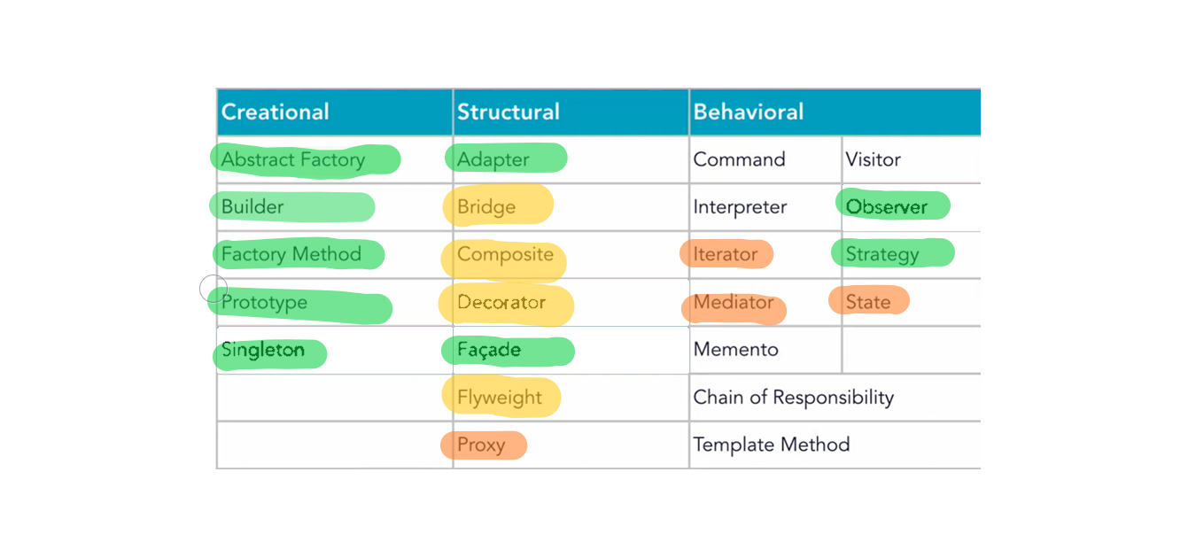
Summary
Figure: 23 Gang of Four (GOF) Patterns

Slide 17
Any questions?

